Slide 1

Flying High with Highly Available Deployments
Aaron West, SIOS Technology Corp., SE
Notes:
Hi my name is Aaron West and welcome…..
About me
Goal
Hi and welcome to my introduction to High Availability.
My name is Aaron West… And I do have a small confession to make up front… I’m not really a SQL expert… while I have worked with various SQL databases in my career I certainly won't have the deep hands on knowledge of many you here today.
Where I do have experience is that I’ve spent the last 13 years working for vendors providing HA and Load Balancing solutions and I now work for a vendor specialising in HA and data availability.
My goal today is really to introduce you all to the idea high availability, what it is..? and how it can apply to your SQL server environments.
We’ll be keeping it quite high level, focusing on the general concepts and also later where SIOS the company which I now represent can fit into such a solution.

Slide 2

Introduction to High Availability - What is HA?
Definition: High availability or HA ensures continuous access to critical systems, minimising downtime and ensuring business continuity.
Importance: Essential for critical applications such as SQL Server to ensure uninterrupted access to data and services.
Notes:
What does HA Mean
Definition
Importance
So let us talk about what exactly HA means and some specifics about how we can deliver HA for SQL server.
Let’s tackle the first bullet point on this slide… The Definition.
The definition as simply as possible is that you have a system designed to withstand failure and continue functioning, I use better words on the slide but that’s all we’re talking about in reality. Straight forward right..? But how do we really achieve it….
More practically this is done by moving resources such as applications, data and IP addresses between nodes or in some other way having them shared (All Active / SAN / DNS or RHI or Anycast).
The second bullet point talks about the importance…
All it is really saying is that HA is required for any system deemed important enough within your organization that it cannot withstand an outage and databases are typically such systems.
Further to these points I’d add that we live in a digital world where outages of our favourite systems and applications such as a social media sites to use an example can really ruin our day… Let alone more serious applications such as medical imaging systems where you may one day rely on it’s availability to get critical treatment.
I think in truth today more than ever HA is very important and is needed pretty much everywhere.

Slide 3
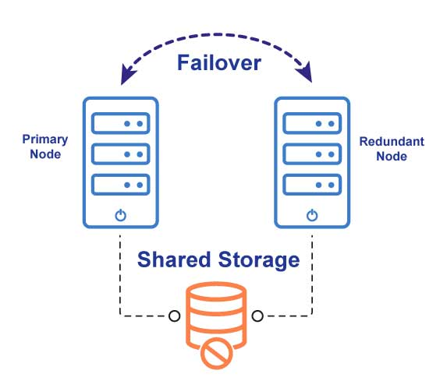
What does it look like:
Notes:
Talk through diagram
Failover between 2 nodes
Shared storage
Active/passive arrangement.
So
What does HA actually look like:
We have here a very simple diagram showing one way to achieve HA, on the top we have a dashed arrow between two servers saying “Failover”, this represents the failover of such resources as applications like SQL databases and other items such as those used for client access like IP addresses. There can be more than one application in such a solution and the IP address used for client access could instead for example be an EIP in Amazon or even an interaction with a Load Balancer in Azure to name a few more examples.
Storage in this diagram is simply referred to as shared storage and can be a wide range of things from iSCSI, to SAN, or even NAS to name a few of the common solutions. HA here is important too and while using technology such as RAID can protect your data you do also need to consider the time it might take to replace hardware and reinitialise should a failure occur. There are solutions that can offer better availability than RAID alone but they can also be costly.
The diagram represents a typical Active/Passive node arrangement as used in many applications that support HA for availability.

Slide 4

HA in the real world!
The Solution
Bullet 1
Bullet 2
The Results
Bullet 1
Bullet 2
Notes:
Real world example of HA
Passenger airplanes fundamentally designed due to safety regulations to have 2 engines.
They must be able to fly and land safely at their destination even in the event of failure.
If only IT systems were always designed the same
Now for a quick real world example as well as my shameless tie in to the aviation theme…
Why do passenger airplanes have at least two engines although they can fly and land on one…
Planes can indeed fly on just one engine. This is a fundamental aspect of their design and safety regulations reinforce this capability. By law, planes are required to be capable of flying from one point to another, even over water, while only using only one engine. This regulation ensures that in the event of an engine failure mid-flight, the plane can continue flying safely until it reaches its destination, powered by its remaining engine(s) and fuel supply.
pretty awesome right? So truly an example of HA in the real world!
Taking it back to IT systems, this is exactly how they should built too, with enough redundancy to continue working even after a failure…
I think it’s very important to plan for failure and build in redundancy and I think that the safety record of passenger aircraft is a testament to this design philosophy which we can all learn from.
If only many big IT systems were built the same way …

Slide 5
Different types of HA…
High Availability Options
Clustering
Load Balancing
DNS (GSLB)
Shared Storage
Block-level Mirroring
Simple Data Replication
Application dependant HA requirements:
Data must also be highly available to ensure functionality
One without the other can render the system ineffective
Consideration of options:
Weigh solutions against goals:
SLAs, RPO, and RTO obligations
Strain on engineering resources
Application
Data
Notes:
With that in mind what HA options do we have available…
First I drew this line to separate HA of the application and client access and the HA of the data
These are typically different and we at SIOS offer two highly integrated solutions in the form of Lifekeeper and datakeeper to cover both
Clustering solutions
Load balancers
DNS
Below data line —-------------
Shared storage with RAID or clustered…
Block level mirroring or SANless clustering
Simple data replication like rsync or even log shipping…
Mixing solutions such as Availability groups and a load a balancer for scale and huge read workloads
or FCI and Datakeeper
So with that in mind…. We have different ways to achieve HA, and how you achieve it will depend on your goals...
First, I wanted to highlight that application HA and HA of the data are usually quite separate and have separate solutions.
For example we at SIOS offer two solutions. These are complementary and highly integrated in the forms of LifeKeeper and DataKeeper and offer both application HA as well as HA for your data solving both problems at once.
I drew the Application and Data line on this slide while considering this and mention some common solutions for both above and below.
For example… we have…
Clustering solutions such as Windows Failover Clustering or indeed SIOS Lifekeeper which both focus on application availability, They will handle Failover of such resources as IP addresses for client access and applications. They work to guarantee application uptime intelligently integrating with services to monitor and failover as necessary.
When scale is required Load balancers can be introduced and can also perform HA, primarily for the client access part but they can also distribute load among many servers and monitor server health externally.
Then we have DNS, which while an incredibly simple solution can in fact offer you HA as long as your DNS solution supports health checks and failover. Anything that claims to be a GSLB or indeed many cloud vendors services such as Amazon’s route53 offer such features. Here though you must consider speed of failover as DNS lookups are often cached so failover may not be as instant or even the same for all users.
Sometimes you will need to even combine solutions, clustering Microsoft SQL server with Availability Groups for HA but utilising a load balancer to distribute the read workload over your secondary replicas if your workload requires it…
Or even using SIOS DataKeeper with Failover Clustering to achieve a cost effective and performant cluster.
Now let’s talk data availability as we’ve mentioned Datakeeper now - When dealing with something like a database it’s not just the application but also the data that needs to be highly available as I’ve mentioned before.
In some cases your availability requirement may mean that you only need to be able to restore your data to a new server within a few hours. In such cases a backup solution might be enough with easy access to hardware or cloud resources at your disposal…
You could use something like a SAN or even a NAS, the SAN will offer you much better performance and both will offer RAID for data protection and can be accessed by multiple servers. The better ones also commonly have some level of hardware redundancy built into the chassis such as redundant SAN controller boards or redundant power supplies and network cards. But high end SAN’s can still be cost prohibitive and I’ve seen them fail before even the best ones…
From there you could explore fancy new scale-out solutions which are really cool and utilise multiple nodes to store data. they can withstand node failures up to a point, you typically decide by the number of nodes you build into the cluster how many node failures they can survive. these are amazing systems built for HA but are expensive and being a shared resource can still have contention issues, in fact these solutions are often load balanced in some way to try distribute traffic more fairly to avoid such issues. Similarly there are solutions in the cloud but these too can be cost prohibitive.
Other solutions include block level drive replication such as SIOS’s own Datakeeper which creates what we call SANless shared storage, I’ve mentioned that earlier and we’ll talk more about it soon enough. Lastly simple data replication such as rsync or for a more SQL focused example log shipping would be another option although really it’s more backup than HA.
You’ll need to decide what level of HA you require for both the application and the data and then see what solution or combination of solutions fit…

Slide 6
Number of 9s - The Availability Matrix
Continuous Availability System Fault Tolerance 99.999% availability – 5.25 minutes/yr
Stateful, Continuous Operation
BMS, Regulated Industries
$$$$$
Essential Applications, Databases, ERP Systems (eg. SQL Server, Oracle, SAP S/4HANA)
High Availability Failover Clusters 99.99% availability - 52.5 minutes/yr
$$$$
Just Availability
Automatic Application Restart 99.9% availability for Infrastructure & App – 8.76 Hrs/yr
Application Availability Protection Level
VMware Applications (eg. DB2, MySQL, Samba, NFS Server, NAS, WebSphere MQ)
$$$
AWS Applications
(eg.Web Server - NGINX, Apache)
Infrastructure Availability
Default 99% availability for Infrastructure – 3.65 Days/Yr
Backup
Archive
$$
0% No Reliability
Spot Instances/Stand Alone Servers
Non-Critical
Important
Mission-Critical
Application Criticality
Notes:
Favourite part when considering HA… Number of 9’s…
Describe chart
Discuss number of 9 and how much downtime they allow…
Now for my favourite part when considering HA… The number of 9’s…..
This chart is designed to highlight the different layers of availability and to illustrate the level of availability provides, so number of 9’s.
Starting at the bottom we have “No Reliability”, which offers ZERO 9’s of uptime. We then work our way through the other levels all the way to the top where “Continuous Availability” provides us with a FIVE 9’s of uptime.
A 5 9’s SLA sounds great of course, but what we need to take into account is that the higher the level of availability guarantee required, the higher the cost. Equally the THREE 9’s achieved by “Just Availbility” often isn’t enough…
We find that the sweet spot is in that FOUR 9’s of availability zone. It provides us with a more than adequate level of SLA for critical applications whilst also keeping the solution cost effective.
Another interesting point that I think is often overlooked is just how much uptime you can expect from the number of 9’s, this slide handily provides that, for example:
3 9’s would equate to 8.76 hours per year of downtime potentially… That could be a lot when you consider that this is unplanned downtime.
4 9’s get’s us to less than one hour a year which is much better sounding
while 5 9’s would be just over 5 minutes per year total downtime which sounds like quite an achievement to me…

Slide 7

Importance of High Availability for SQL Servers
Minimising Downtime
Business Continuity
Meeting Service Level Agreements (SLAs)
Regulatory Compliance
Customer Satisfaction
Notes:
So let’s consider the importance of HA for SQL Servers in general and how it relates to business… The bullets above are some typical business requirements…
Minimizing Downtime:
High Availability configurations will help minimize downtime by providing mechanisms for automatic failover. Should one server in the HA configuration goes down, another server takes over seamlessly, reducing the impact on users and applications. This will typically be a key driver for the need for HA.
Business Continuity:
HA is one component of ensuring business continuity by helping maintain access to critical applications and data. High availability is always crucial for organizations that rely heavily on databases for their day-to-day operations.
Meeting Service Level Agreements (SLAs):
Many organizations have SLAs that define the acceptable levels of system availability. Implementing HA for SQL Server will help meet these SLAs and ensures that the database infrastructure meets the required reliability standards as outlined in your organisation.
Regulatory Compliance:
In certain industries, there are regulatory requirements that mandate high levels of data availability and protection beyond your own internal mandates. Implementing HA helps organizations comply with these regulations and avoid legal and financial consequences.
and Finally Customer Satisfaction:
Uninterrupted access to data and applications contributes to customer satisfaction. For businesses that provide online services, e-commerce platforms, or other critical applications, maintaining high availability is crucial for retaining customers and building trust.
So we can see from this list the importance of HA in our organization, and how it can help us meet common business targets.

Slide 8
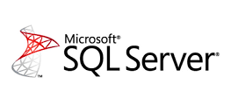

High Availability for Microsoft SQL Server
Microsoft SQL Server
Instance level HA:
Failover clustering instance (FCI)
Database level HA:
Log shipping, which is really just a backup
Availability Groups
Database Mirroring (Deprecated)
Notes:
Microsoft SQL Server and what options we have at our disposal…
Discuss Instance level - FCI “Failover Clustering Instances” options inc storage
Storage performance needs can lead to extreme costs
Discuss database level solutions
For availability groups it offers additional scale for HUGE workloads, potenstially scale read load using an LB
Now let’s look more specifically at Microsoft SQL Server and what options for HA we might leverage….
Here we are offered various solutions we can use for HA, the reason I picked on Microsoft SQL here is because it offers us so many solutions that are well defined and supported.
Breaking them down we have instance level solutions such as FCI or to use it’s full name “Failover Clustering Instances” which protect the entire instance taking advantage of the inbuilt windows server failover clustering mechanism. This means it fails over everything, not just the database but the IP address too although it does expect some kind of shared storage to function.
For high performance needs this can get very expensive as shared storage will often come in the form of a SAN or an iSCSI target. Although cheaper options do exist such as using SMB shares may be hosted on a cheaper NAS or other server… It should also be noted that SMB shares will not offer the same performance and even when you have faster shared storage do be careful of it being used for other tasks that may contend access speed as we’ve previously discussed.
Now we have Database level solutions… Where we replicate the database itself to other nodes
We have the simplest form… log shipping which itself is really just a form of backup solution so falls a little short of true HA. It can lead to data loss where the latest transactions have not been shipped or even applied yet plus it will require you to repoint your application at the new server offering no automatic failover solution itself.
Next we have Availability groups! This will allow you scale as it creates one primary replica but multiple secondary replicas which can still be used for tasks such as reading, you could as mentioned use a load balancer here too! However, it does require more expensive enterprise licensing to achieve… So cost effective it is not but if you need the scale aspect or other features offered by the required enterprise licensing it may well be the best choice even if it can get expensive.

Slide 9
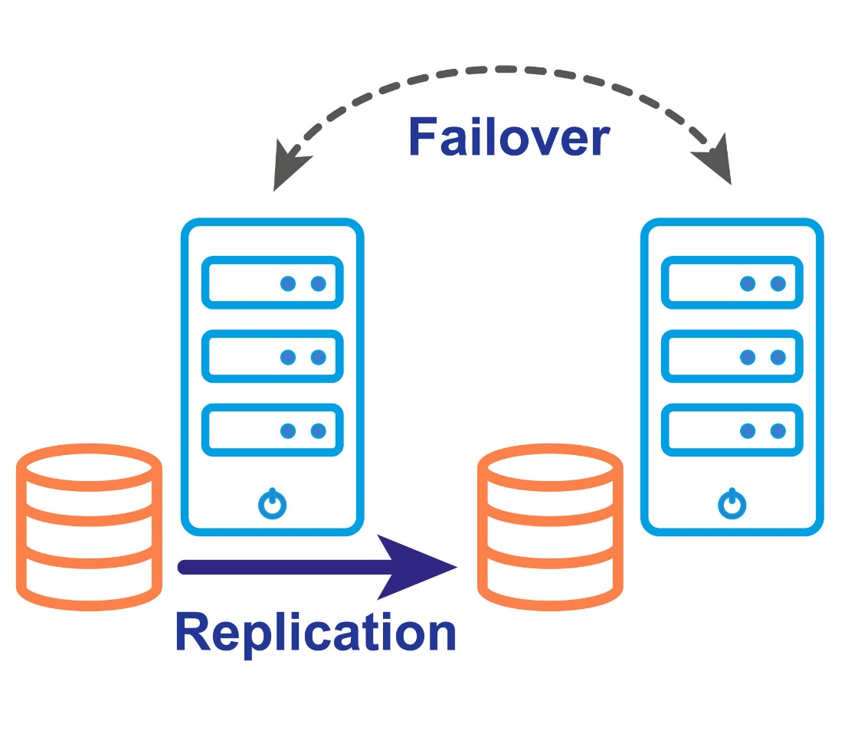

High Availability for SQL Server with SIOS
DataKeeper Cluster Edition
Block-level data replication
Clustering without shared storage
Synchronous or asynchronous modes
Works across cloud-regions and availability zones
Notes:
Discuss how SIOS can fit in, adding datakeeper for resilient fast storage we call SANless clustering
Diagram similar to earlier but it shows clustered replicated storage
Windows FCI can be used for the application and client access HA
Helps to reduce licensing costs by not requiring Enterprise licenses
Okay, so here’s where I can talk about SIOS a bit more and where we can help you with Microsoft SQL…
We offer another solution, an alternative to expensive shared storage or low performance network shares that still integrates with Failover Clustering letting you reduce both storage and licensing costs…
We do this by offering block level replication of local storage with proper integration with Windows Failover Clustering so it’s recognised as a supported form of shared storage (although it’s not truly) so it can can be used to form a supported cluster configuration.
This allows you some benefits like the ability to use cost effective local storage while also maintaining great performance and availability.
or maybe even, leveraging super high performance specialist local storage devices guaranteeing peerless performance.
As mentioned it will also help you minimise licensing costs as it doesn’t require enterprise licensing to achieve which can really offer some impressive savings indeed.
As you can see in the diagram, it’s very similar to the earlier one but the data is being replicated between instances using local storage not a shared solution. That is DataKeeper… Replication can be Synchronous or Asynchronous as desired although do keep in mind that Asynchronous offers the best performance if that’s truly what you seek.
Windows clustering is doing the rest such as the application and IP address failover keeping things rather simple as no additional complexities are needed.

Slide 10
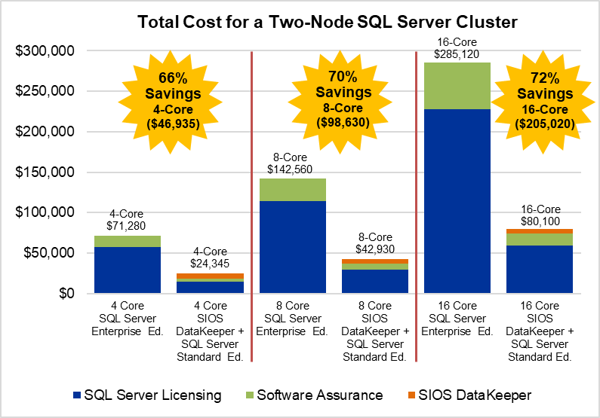
SIOS Saves Licensing Costs
SIOS DataKeeper and SQL Server Standard Edition
High Availability Cluster Protection for 70% Less
Protection for Older (& latest) Versions of SQL Server
Protection for Master System Databases (Master, MSD)
Enables Multi-node Clusters
Notes:
For those interested in those cost savings we show what can be achieved on this slide… again we’re looking at Microsoft SQL Server.
It compares a two-node SQL cluster looking at how SIOS DataKeeper can consistently save you around 70% on your licensing costs vs SQL Server Enterprise Licensing…
I think that pretty impressive personally!!!! Sign up for my colleague Harry’s season tomorrow for a deeper dive into the cost benefit of SIOS.

Slide 11


High Availability for SQL Servers
Other SQL Servers Windows and Linux
Generally you’ll see:
Clustering solutions
Replication Solutions
For all databases.
And where we don't have Windows Failover Clustering you can still use LifeKeeper and DataKeeper to provide the HA for applications and data. Our solutions work with both Windows and Linux so offers a very wide variety of support across platforms.
SIOS DataKeeper Cluster Edition
Replication to Enhance Windows Server Failover Clustering (WSFC)
SIOS LifeKeeper for Linux
Enterprise-Ready Linux Clustering
Notes:
Discuss how up to now I’ve mostly focused on Micrsoftr SQL as the example but we have solutions for many platforms and databases.
While I’ve focused on Microsoft SQL server today so as not to try and cover too much at once, I want to share that SIOS offer wide ranging support for databases and other operating systems.
Most applications such as databases will support some kind of clustering which typically leaves us with solving the shared storage requirement plus the client access and application failover requirement.
I’ve mentioned LifeKeeper once or twice… Lifekeeper handles the client access and application failover similarly to windows failover clustering but can be used when Windows clustering isn’t an option such as in workgroups or even on Linux to achieve the same results. It’s extremely flexible and can be used for a wide range of applications too.
LifeKeeper also offers integrates with Hyperscale cloud environments like AWS, Azure and GCP to name a few of the more common ones so for example you can interact with EIP’s and load Balancers to control failover without needing to script anything by hand.

Slide 12
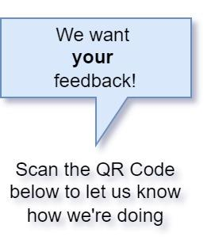


Q & A
 | We are at Stand 11 (next to Gate 3)
 | Prizes!!! – Star Wars Lego!
 | Don’t forget the SQLBits Famous Friday Night Party!
Important Info
Notes:
Well that brings us to an end… I Hope you found that useful!
I’m going to turn it over to Questions and Answers now to demystify anything I might of overlooked.

Slide 13
Notes:
Well thanks everyone for your time today
Come and check us out on the web at us.sios.com where you will find lot’s of information publicly available for your consumption.

